Slide 1
Travel ai agent
IBM HACKATHON PROJECT
Presented By:
Student name : Aniket Kumar Verma
College Name & Department : Indira Gandhi National Open University
AICTE Student-ID : STU66ab8e341a0a41722519092

Slide 2
OUTLINE
Problem Statement
Technology used
Wow factor
End users
Result
Conclusion
Git-hub Link
Future scope
IBM Certifications

Slide 3
Problem Statement
Travel planning is time-consuming and often overwhelming due to the need to research destinations, compare prices, check weather, and book accommodations. Proposed Solution: An AI-powered Travel Planner Agent that leverages real-time data and user preferences to provide personalized trip planning, including itineraries, bookings, weather updates, and local guides.

Slide 4
Technology used
IBM Cloud Lite (deployment platform)
IBM Watsonx (conversation flow)
IBM Granite Model (optional: LLM-based itinerary)
Natural Language Processing (NLP)
OpenWeatherMap API (weather info)
IBM Watsonx AI Runtime

Slide 5
IBM cloud services used
IBM Cloud Watsonx AI Studio
IBM Cloud Watsonx AI runtime
IBM Cloud Agent Lab
IBM Granite foundation model
IBM Cloud Object Storage (optional for data storage)

Slide 6
Wow factors
Personalized itinerary creation using AI Real-time weather and location suggestions Web-based chatbot and app integration Granite-powered travel recommendations (optional) Helps users optimize cost, time, and experience

Slide 7
End users
Frequent Travelers
Travel Agencies
Students planning trips
Corporate Travel Planners
Tourism Boards

Slide 8
Results
Fully working travel planner hosted on IBM Cloud
Weather, destination, and itinerary customization
Optional chat-based interface using Watson Assistant
AI-generated itinerary powered by user inputs

Slide 9
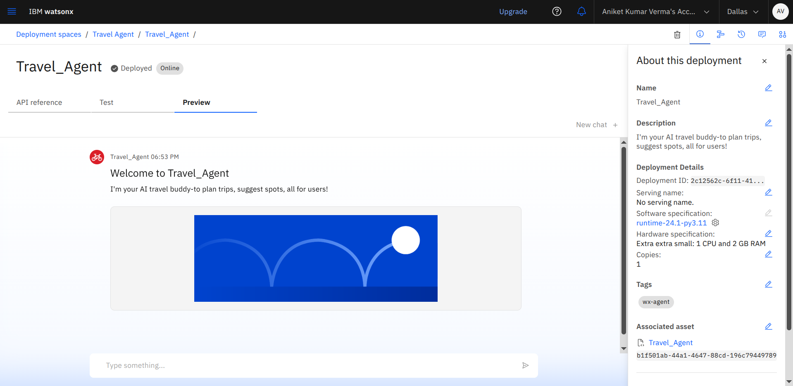
Results

Slide 10
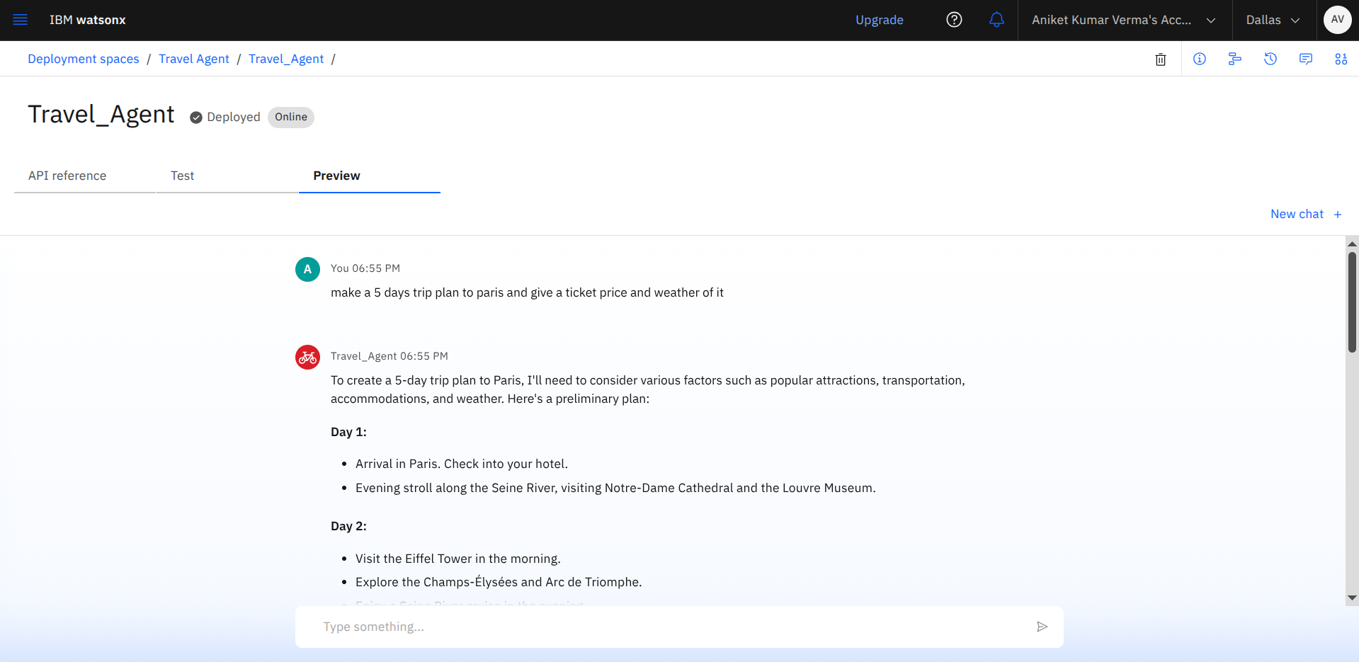
Results

Slide 11
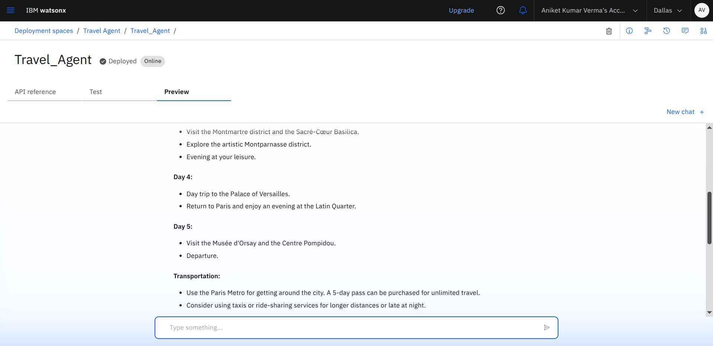
Results

Slide 12
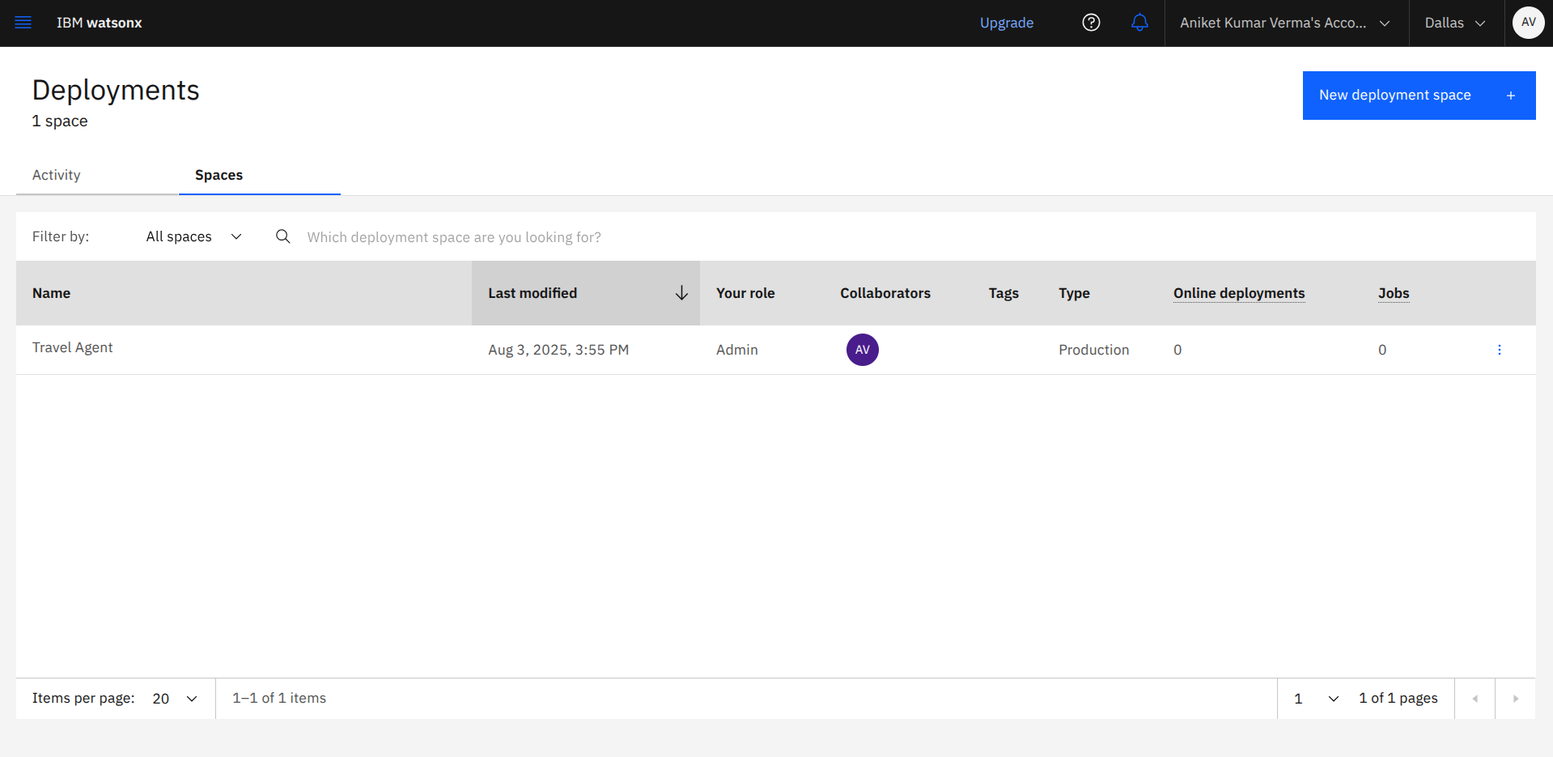
Results
Deployed AI Agent

Slide 13
Conclusion
The Travel Planner Agent successfully demonstrates how AI can transform the travel planning process into a seamless, intelligent, and user-friendly experience. By integrating real-time data, conversational AI, and smart recommendation systems on the IBM Cloud platform, the agent simplifies trip planning, personalizes itineraries, and enhances decision-making for travelers. This solution not only saves time and effort but also ensures a more enjoyable and optimized travel journey. It reflects the potential of AI-powered assistants in real-world applications and opens doors for further innovation in the tourism and hospitality domain.

Slide 14
GitHub Link
https://github.com/aniketverma-14/Travel-Agent.git

Slide 15
Future scope
Integrate with flight/hotel booking APIs
Voice-based travel assistant
Currency conversion & visa requirements
Real-time alerts for changes
Group travel cost splitting
Visual itinerary map view

Slide 16
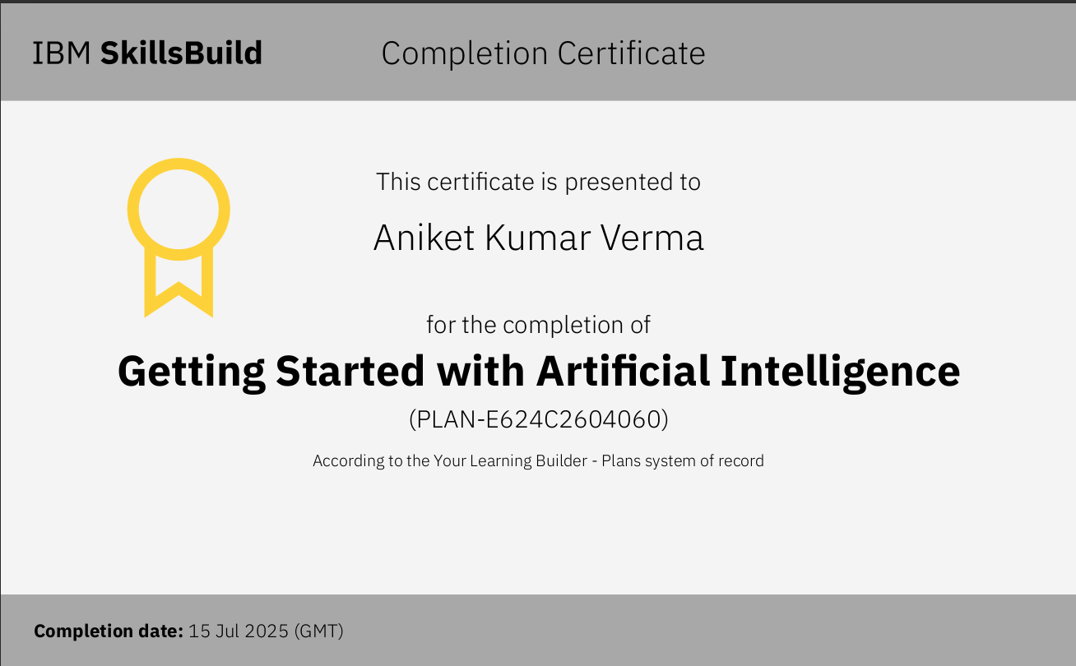
IBM Certifications
Screenshot/ credly certificate( getting started with AI)

Slide 17
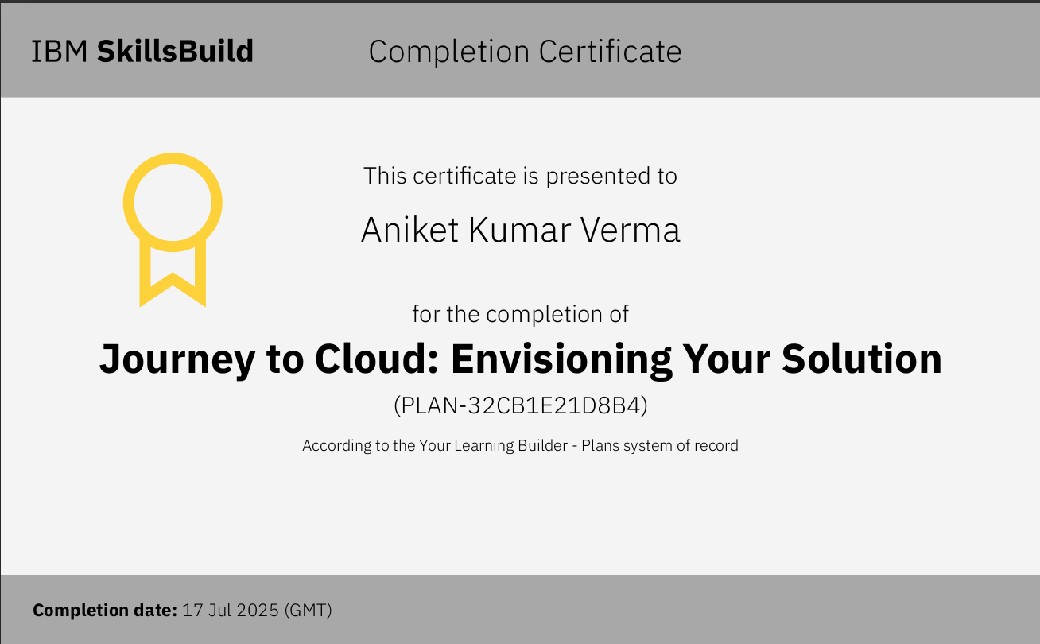

Slide 18
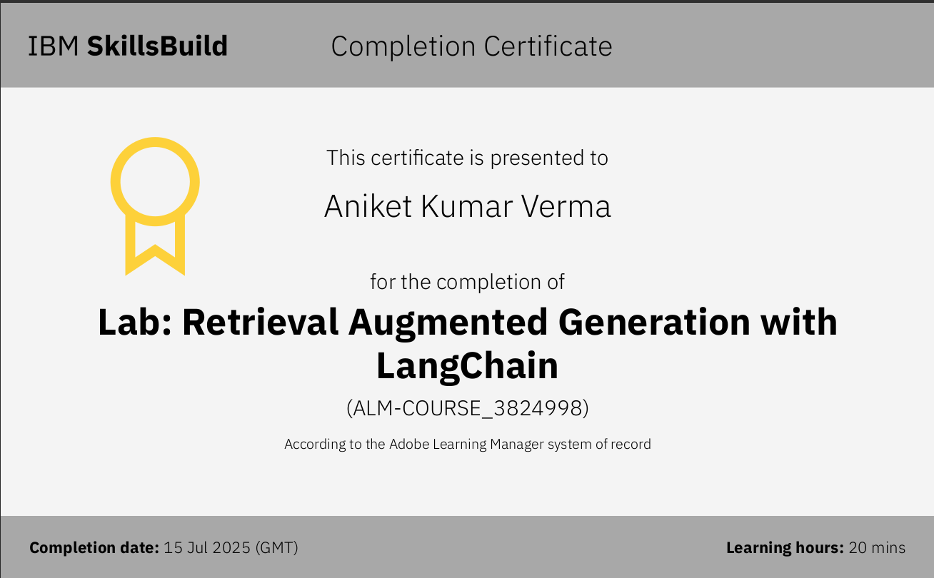
Attach your RAG LAB certificate here

Slide 19
THANK YOU

